Slide 1
Remote Access
Guide
Welcome to secure resource access portal
Access Portal URI: <MAMORI SERVER IP>
Access is authenticated via configured directory and multi-factor providers
This guide covers :
Pre-requisites
First time portal login – setup 2FA
RDP access
SSH access
Web App access
Secret access
Database Web SQL access
Overview
This guide provides instructions on how to remotely access SSH, RDP, Web App and database resources via any standard web browser.
NOTE: If you need to use native clients, then please request native client support from your administrator.

Slide 2
Remote Access
Guide
Pre-requisites
To follow this guide you will need the following items:
1. A Directory Account
If you don’t have one, then contact your administrator.
2. Install the Mamori.io 2FA mobile application
iOS App Store: search for mamori 2FA
Android App Store: search for mamori.io
Note :
When you install the mobile application it will ask you to scan a QR code. This login QR code is displayed the first time you login to the access portal.
Login credentials
Mobile 2FA App

Slide 3
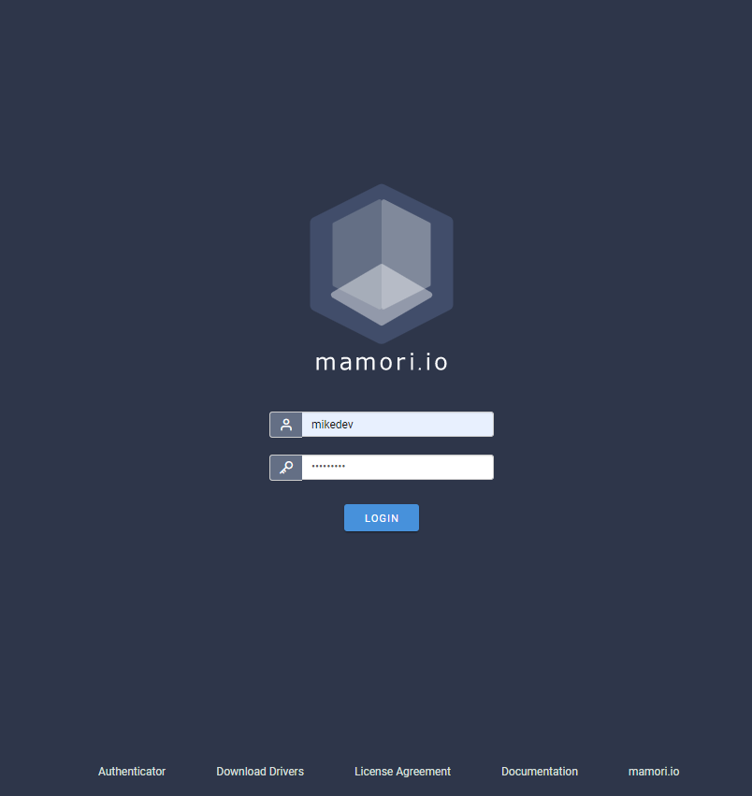
Remote Access
Guide
Portal Login
Login to https://YOUR MAMORI SERVER/
with your provided credentials
Step 1/3
Login with your AD credentials
Scan 2FA QR Code
Login with AD & 2FA

Slide 4
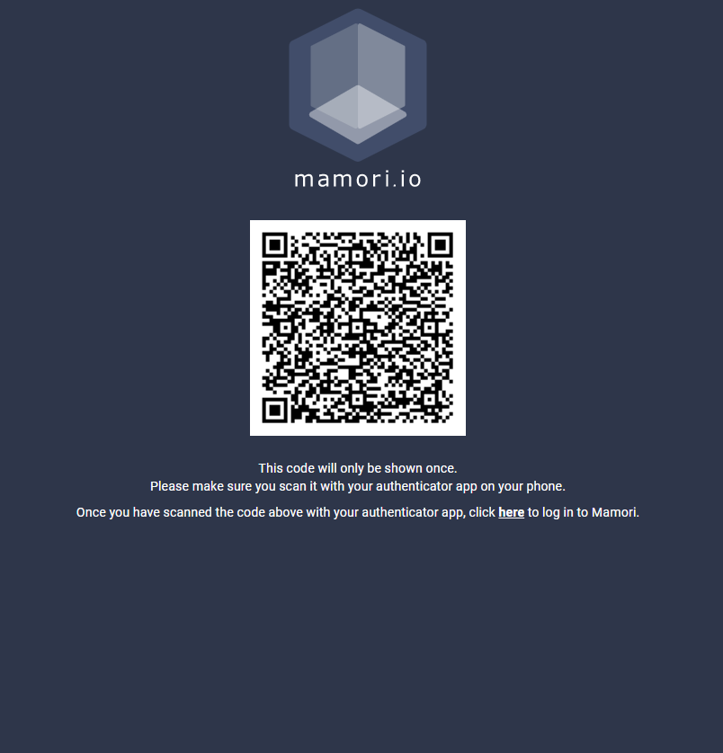
Remote Access
Guide
Portal Login
Scan the displayed QRCode with the mamori.io mobile app
Step 2/3
Login with your AD credentials
Scan 2FA QR Code
Login with AD & 2FA

Slide 5
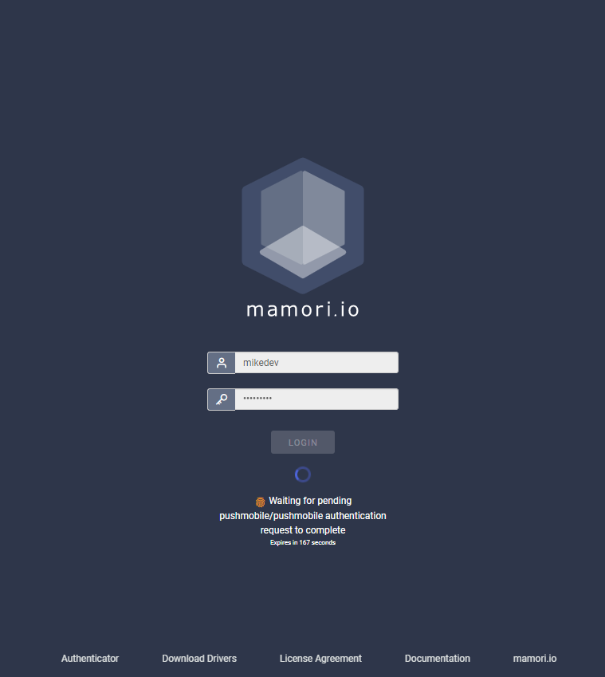
Remote Access
Guide
Portal Login
Login to https:// YOUR MAMORI SERVER / again with your credentials and click Accept on the mobile app
Step 3/3
Login with your AD credentials
Scan 2FA QR Code
Login with AD & 2FA

Slide 6
Remote Access
Guide
Portal Login
Your 2FA and mobile device registration is complete.
Next steps in the guide are for connecting to
Remote Desktop
SSH
HTTP/S
Secret
Database WebSQL Access
2FA Setup Complete
You will need to do this for both production and DR servers.

Slide 7
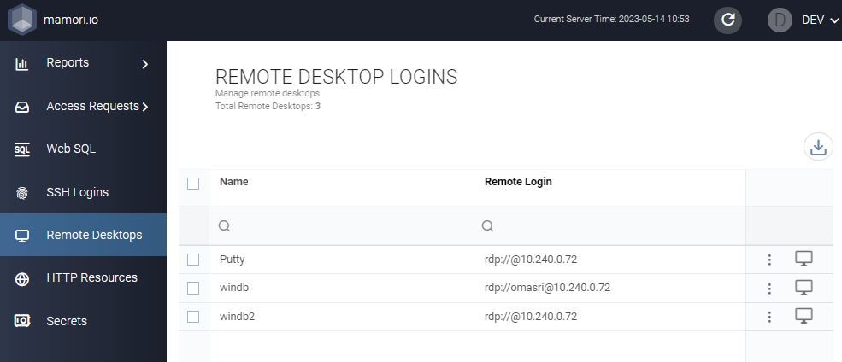
Remote Access
Guide
RDP Access
Click on Remote Desktops & Connect
If the connect button is not available, then click on request access.
Login to the access portal
Click on Remote Desktops & Connect (you will be 2FA verified on every new RDP connection)

Slide 8
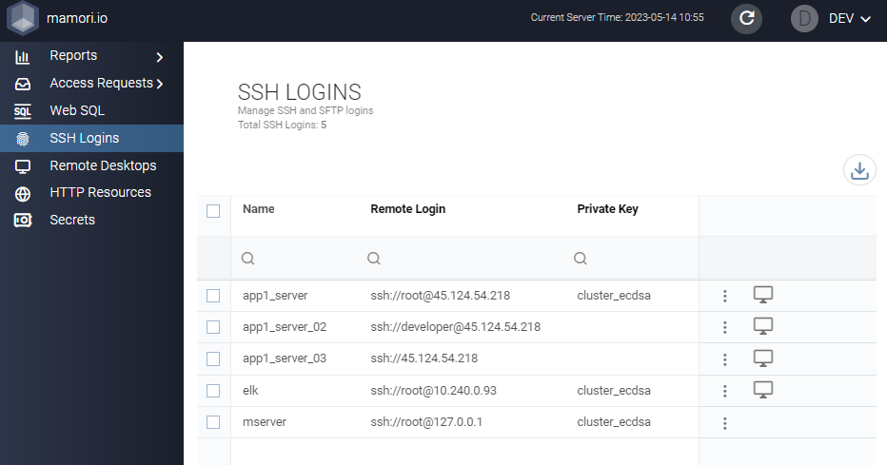
Remote Access
Guide
SSH Access
Click on SSH Logins & Connect
If the connect button is not available, then click on request access.
Login to the access portal
Launch the desired SSH server

Slide 9
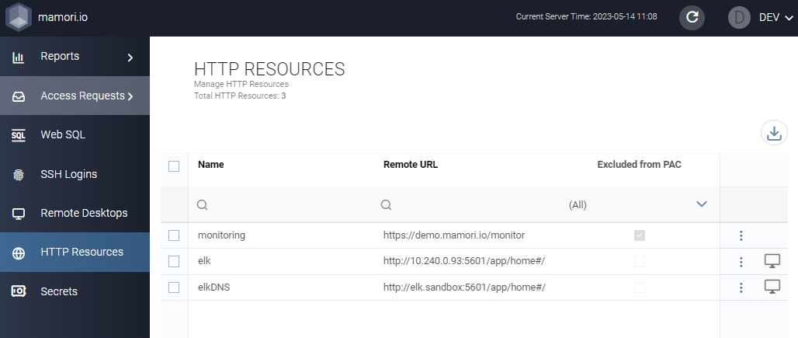
Remote Access
Guide
Web APP Access
Click on HTTP Resources & Connect
If the connect button is not available, then click on request access.
Login to the access portal
Launch the desired resource

Slide 10
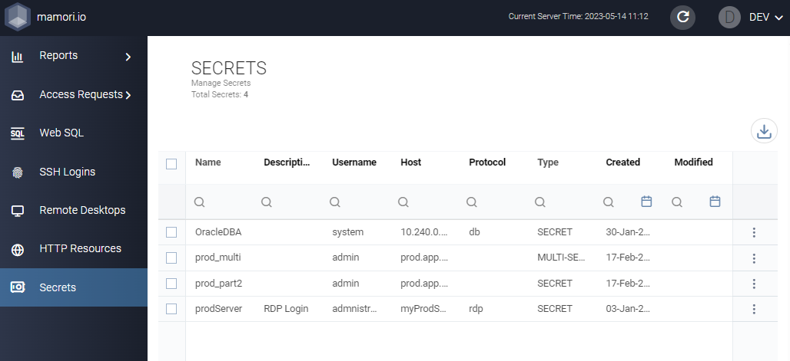
Remote Access
Guide
Secret Access
Click on Secrets & Reveal
If the reveal button is not available, then click on request access.
Login to the access portal
Launch the desired SSH server

Slide 11
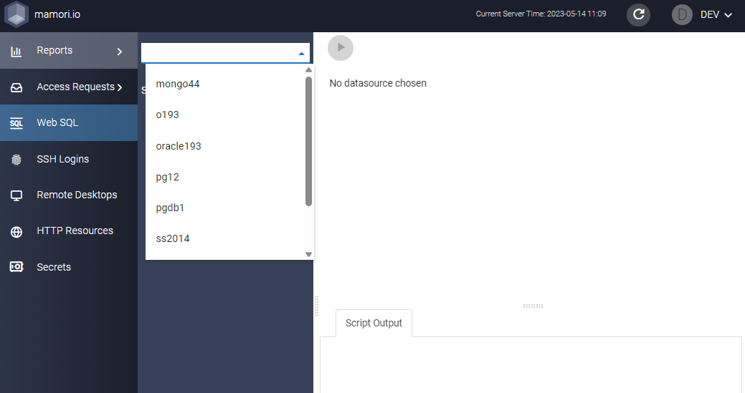
Remote Access
Guide
Database Access
Click on Web SQL & Select Database
Login to the access portal
Select the target database
Run queries

Slide 12
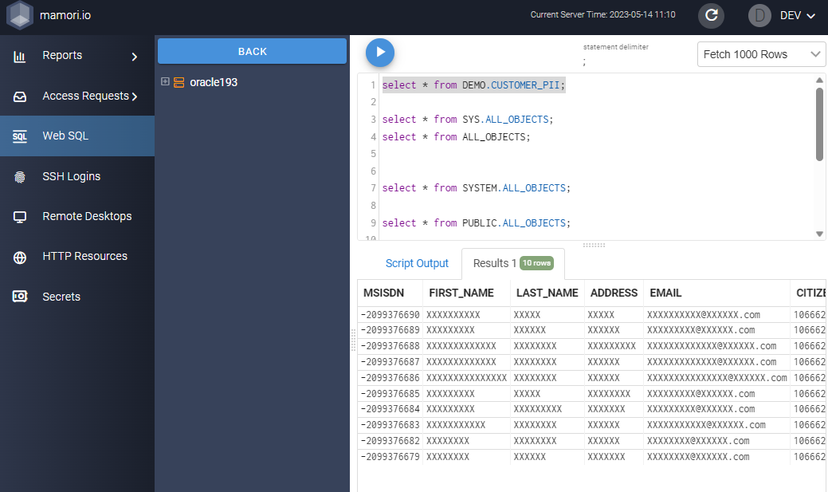
Remote Access
Guide
Database Access
Enter Query and Click Run button
Step 3/3
Login to the access portal
Select the target database
Run queries
Note:
Masking and encryption policies will apply

